Slide 1
Entity Framework Core

Slide 2
Entity Framework Core
Entity Framework (EF) Core is a lightweight, extensible, open source and cross-platform version of the popular Entity Framework data access technology.
EF Core can serve as an object-relational mapper (O/RM), enabling .NET developers to work with a database using .NET objects, and eliminating the need for most of the data-access code they usually need to write.
You can generate a model from an existing database, hand code a model to match your database, or use EF Migrations to create a database from your model, and then evolve it as your model changes over time.

Slide 3
Install Entity Framework Core
Tools ‣ NuGet Package Manager ‣ Package Manager Console
Run
To enable reverse engineering from an existing database we need to install a couple of other packages:
Run
Install-Package Microsoft.EntityFrameworkCore.SqlServer
Install-Package Microsoft.EntityFrameworkCore.Tools

Slide 4
Working With EF Core (Code First From DB)
Tools –> NuGet Package Manager –> Package Manager Console.
Run the following command to create a model from the existing database:
Scaffold-DbContext "Server=(localdb)\mssqllocaldb;Database=Blogging;Trusted_Connection=True;“ Microsoft.EntityFrameworkCore.SqlServer -OutputDir Models

Slide 5
Using EF Core’s AppDbContext(Code First)
1- install Entity Framework Core NuGet packages.
2- Create the data model
3- Create the Database Context
4-Add your connection string to Database Context
5-Add Migration and Update Database.

Slide 6
Configure Database Context
protected override void OnConfiguring(DbContextOptionsBuilder optionsBuilder)
{
optionsBuilder.UseSqlServer(@"Server=(localdb)\\mssqllocaldb; Database=EFGetStarted.ConsoleApp.NewDb;Trusted_Connection=True;”)

Slide 7
Loading Related Data
Entity Framework Core allows you to use the navigation properties in your model to load related entities. There are three common O/RM patterns used to load related data.
Eager loading means that the related data is loaded from the database as part of the initial query.
Explicit loading means that the related data is explicitly loaded from the database at a later time.
Lazy loading means that the related data is transparently loaded from the database when the navigation property is accessed.

Slide 8
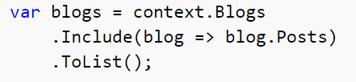
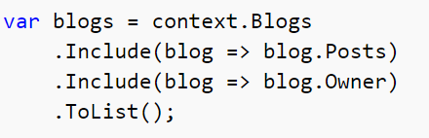
Eager loading
You can use the Include method to specify related data to be included in query results.
You can include related data from multiple relationships in a single query.

Slide 9
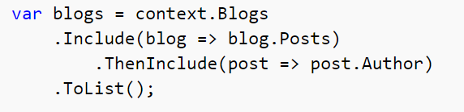
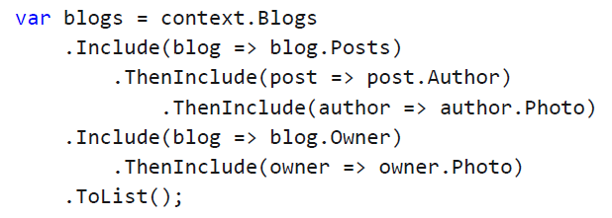
Including multiple levels -Eager loading
You can drill down thru relationships to include multiple levels of related data using the ThenInclude method.

Slide 10
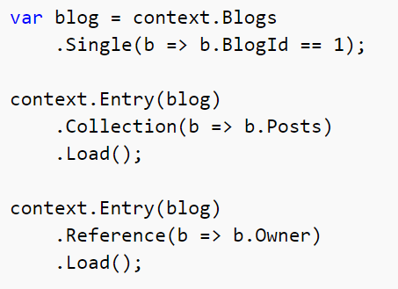
Explicit loading
This feature was introduced in EF Core 1.1.
When the entity is first read, related data isn't retrieved. You write code that retrieves the related data if it's needed.
You can explicitly load a navigation property via the DbContext.Entry(...) API.

Slide 11
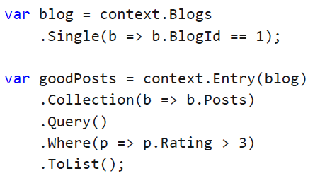
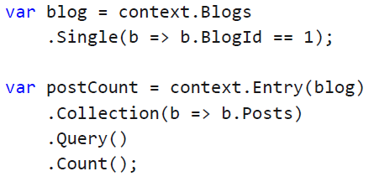
Explicit loading

Slide 12
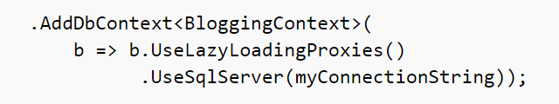
Lazy loading
This feature was introduced in EF Core 2.1.
The simplest way to use lazy-loading is by installing the Microsoft.EntityFrameworkCore.Proxies package and enabling it with a call to UseLazyLoadingProxies when using AddDbContext:
EF Core will then enable lazy-loading for any navigation property that can be overridden--that is, it must be virtual and on a class that can be inherited from.

Slide 13
Performance considerations
If you know you need related data for every entity retrieved, eager loading often offers the best performance, because a single query sent to the database is typically more efficient than separate queries for each entity retrieved.
In some scenarios separate queries is more efficient. Eager loading of all related data in one query might cause a very complex join to be generated, which SQL Server can't process efficiently.

Slide 14
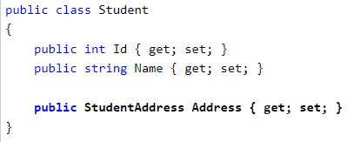
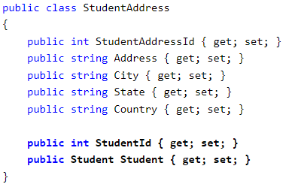
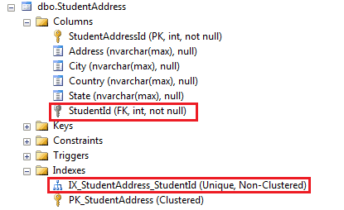
One-To-One relation
Entity Framework Core introduced default conventions which automatically configure a One-to-One relationship between two entities

Slide 15
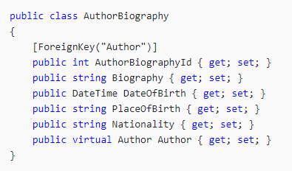
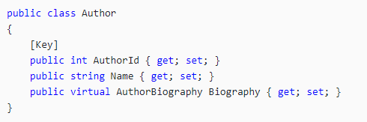
One-To-One relation EF6
In a one-to-one relationship, each row of data in one table is linked to zero or one row in the second table
1-Using Data Annotation

Slide 16
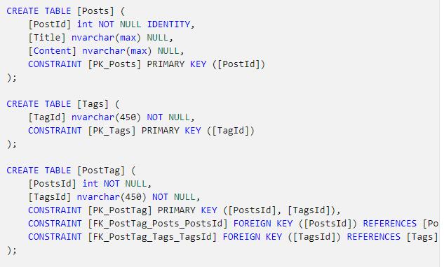
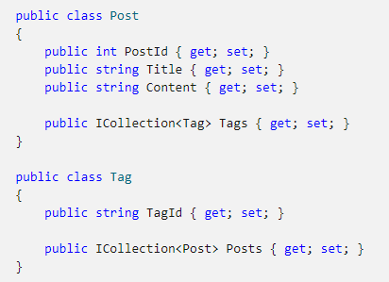
M-to-M
Many to many relationships require a collection navigation property on both sides. They will be discovered by convention like other types of relationships.

Slide 17
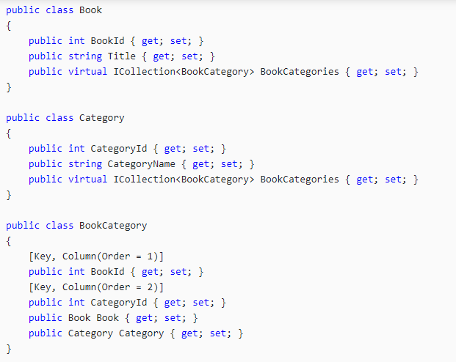
M-to-M
To configure many-to-many relationship Using Data Annotations, you need to create the Join Table in the model.

